Slide 1


Automatic Accessibility Testing
What you can and can not do
digital.canada.ca · @CDS_GC | numerique.canada.ca · @SNC_GC

Slide 2
Agenda
Introductions
Background
Manual tools
Automatic tools
Top issues

Slide 3
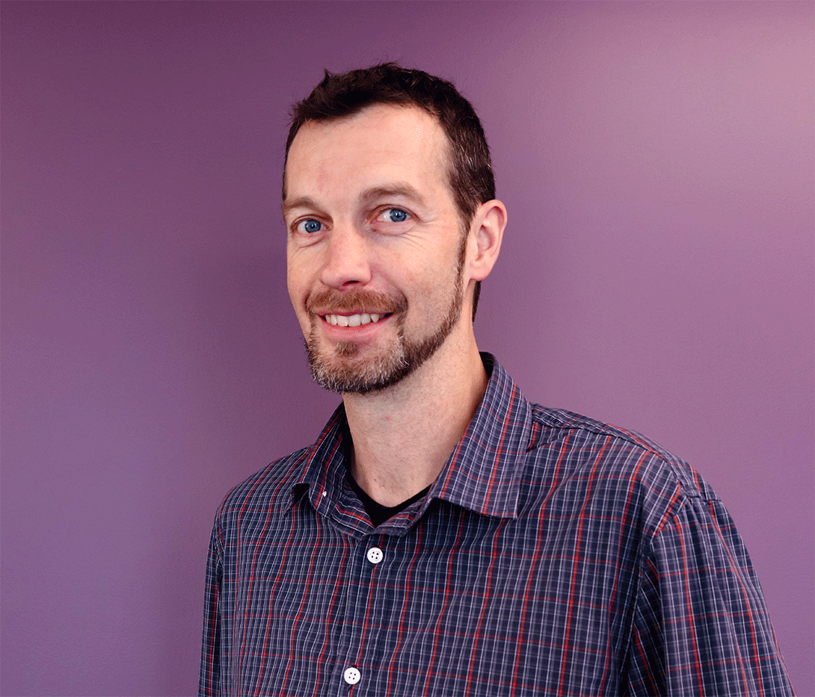

We are:
Tim Arney
Developer
@timarney
Max Neuvians
Developer
@maxneuvians

Slide 4
Help us get to know you
Name
Dept
How are you currently doing accessibility testing?

Slide 5
Good news

Slide 6
There are lots of resources online
The A11Y Project
Accessibility in government
Easy Checks - A First Review of Web Accessibility
Basic screen reader commands
Notes:
Yes.
***
Yes, we believe the evidence is that there is a public need for a simple, quick and reliable way of informing the police of cybercrime.
***
And, yes, we think that CDS is in a good place to partner with RCMP on its development.

Slide 7
Building inclusive services is not about perfection
Julianna Roswell
https://digital.canada.ca/2019/02/13/building-inclusive-services-is-not-about-perfection/
Notes:
Yes.
***
Yes, we believe the evidence is that there is a public need for a simple, quick and reliable way of informing the police of cybercrime.
***
And, yes, we think that CDS is in a good place to partner with RCMP on its development.

Slide 8
A good tool will provide developers with simple remediation guidance and allow them to embark on a learning journey to increase their knowledge and expertise.
Dylan Barrell
https://devops.com/embedding-accessibility-into-the-devops-process
Notes:
Yes.
***
Yes, we believe the evidence is that there is a public need for a simple, quick and reliable way of informing the police of cybercrime.
***
And, yes, we think that CDS is in a good place to partner with RCMP on its development.

Slide 9
Accessibility needs to be part of the development process

Slide 10
As a developer it’s your responsibility to have a base understanding of what to look for.

Slide 11
We can’t rely solely on Accessibility Experts, Automated tools or CSS Frameworks to catch errors

Slide 12
What does this mean:
Developers should be aware of accessibility issues as they create user interface components or design the user experience.
It’s about making an effort and seeing progress. When we bring that type of effort every day, transformation happens

Slide 13
Some bad news

Slide 14
WET != 100% Accessible
Notes:
Yes.
***
Yes, we believe the evidence is that there is a public need for a simple, quick and reliable way of informing the police of cybercrime.
***
And, yes, we think that CDS is in a good place to partner with RCMP on its development.

Slide 15
Automatic accessibility testing is hard
Notes:
Yes.
***
Yes, we believe the evidence is that there is a public need for a simple, quick and reliable way of informing the police of cybercrime.
***
And, yes, we think that CDS is in a good place to partner with RCMP on its development.

Slide 16
Manual tools

Slide 17
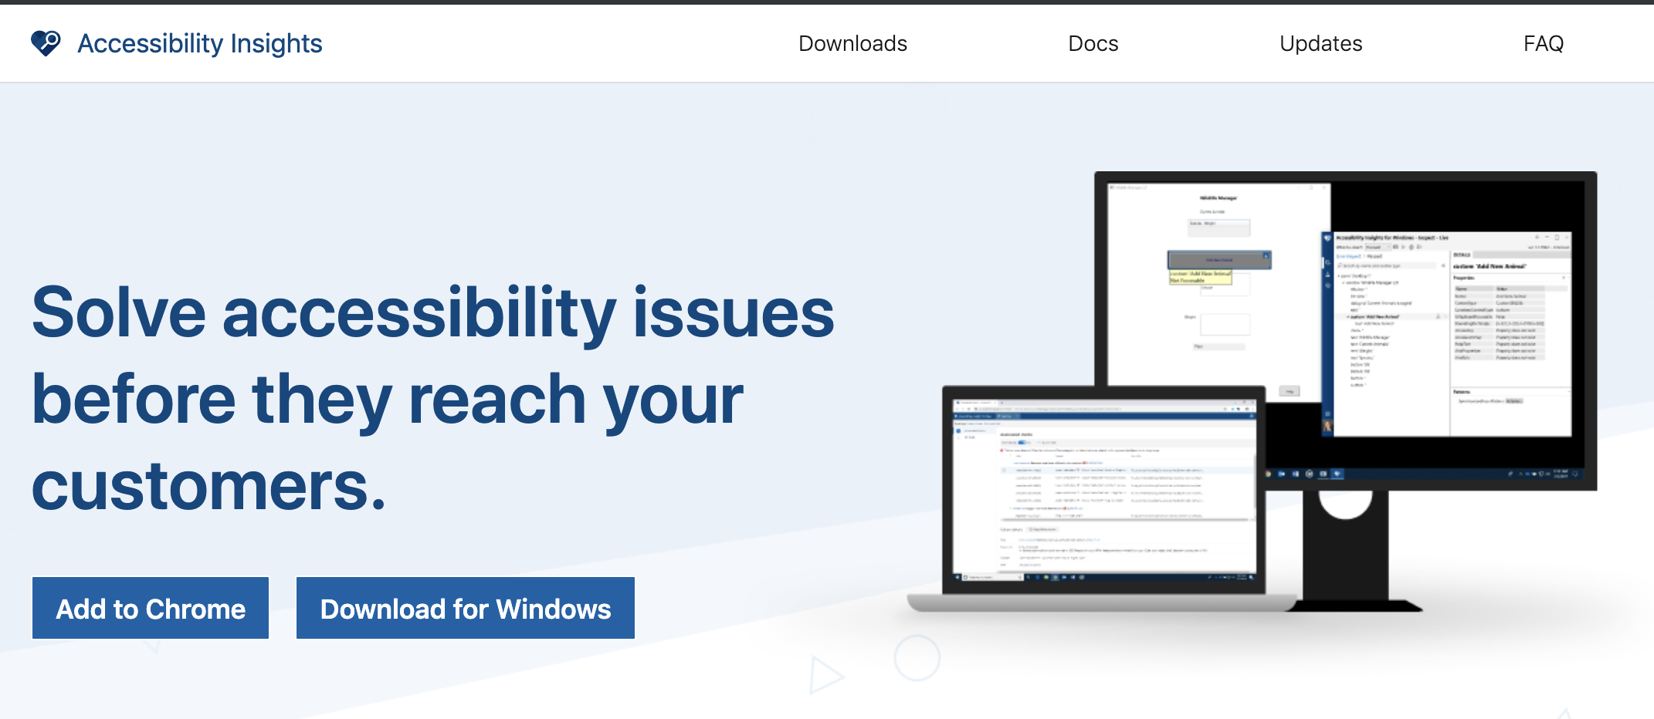
Accessibility Insights
https://accessibilityinsights.io

Slide 18
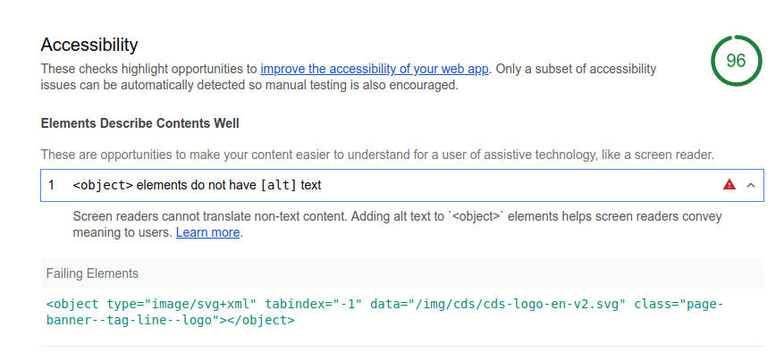
Lighthouse tool

Slide 19
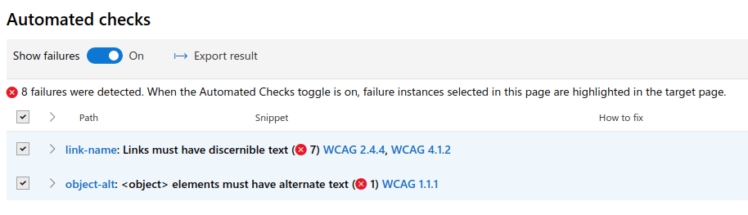
Lighthouse tool

Slide 20
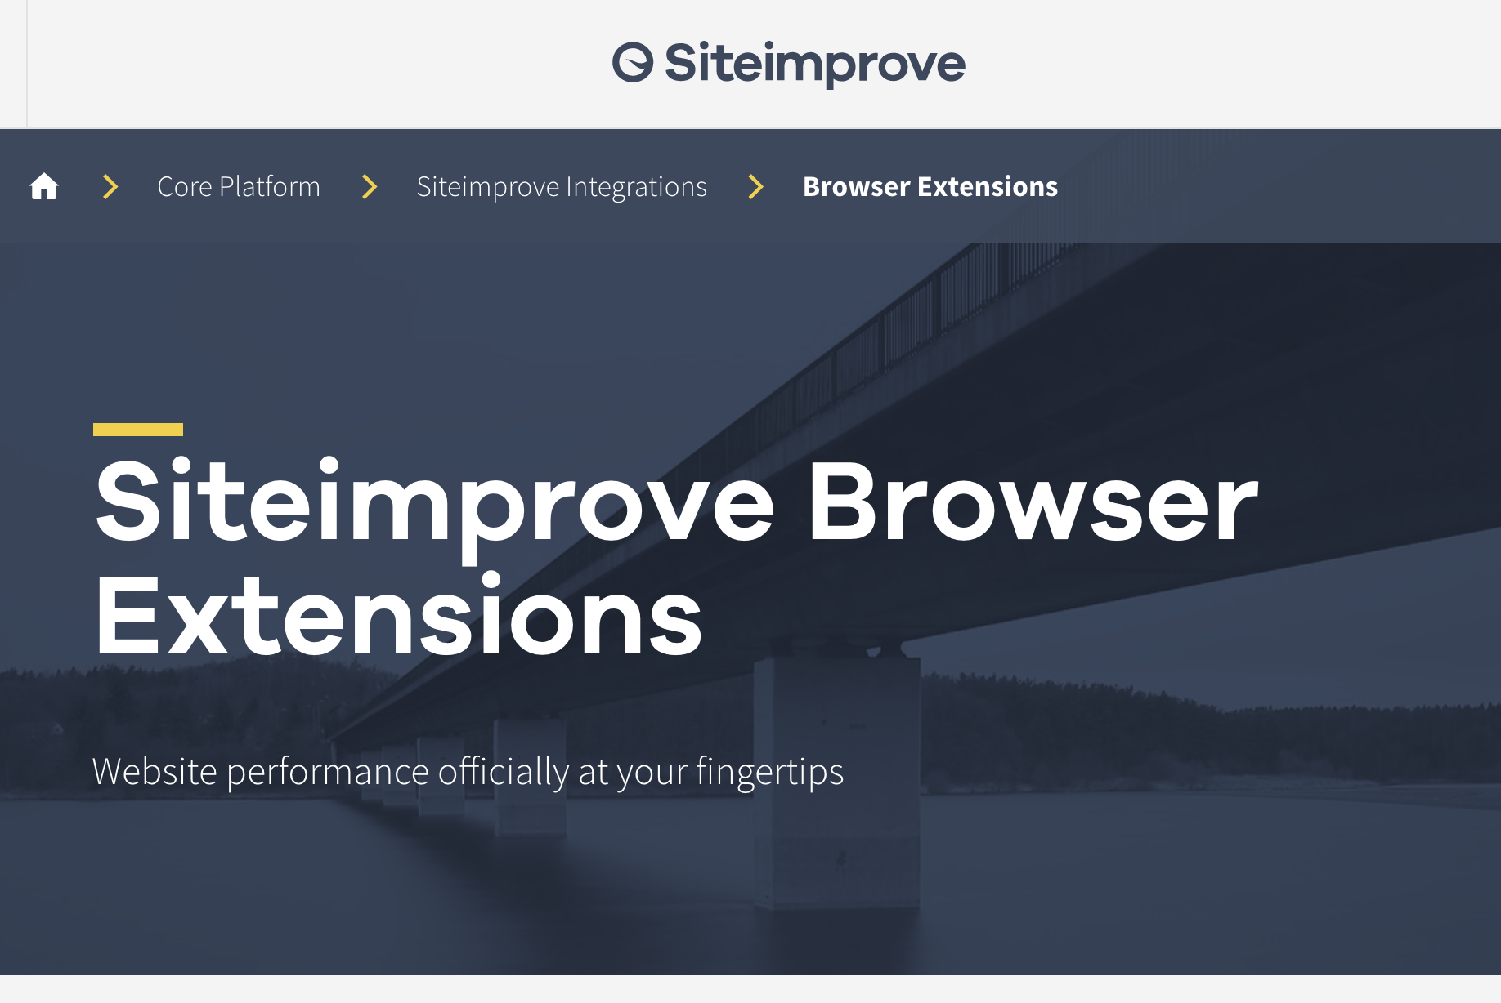
SiteImprove Browser Extension
https://chrome.google.com/webstore/detail/siteimprove-accessibility/efcfolpjihicnikpmhnmphjhhpiclljc?hl

Slide 21
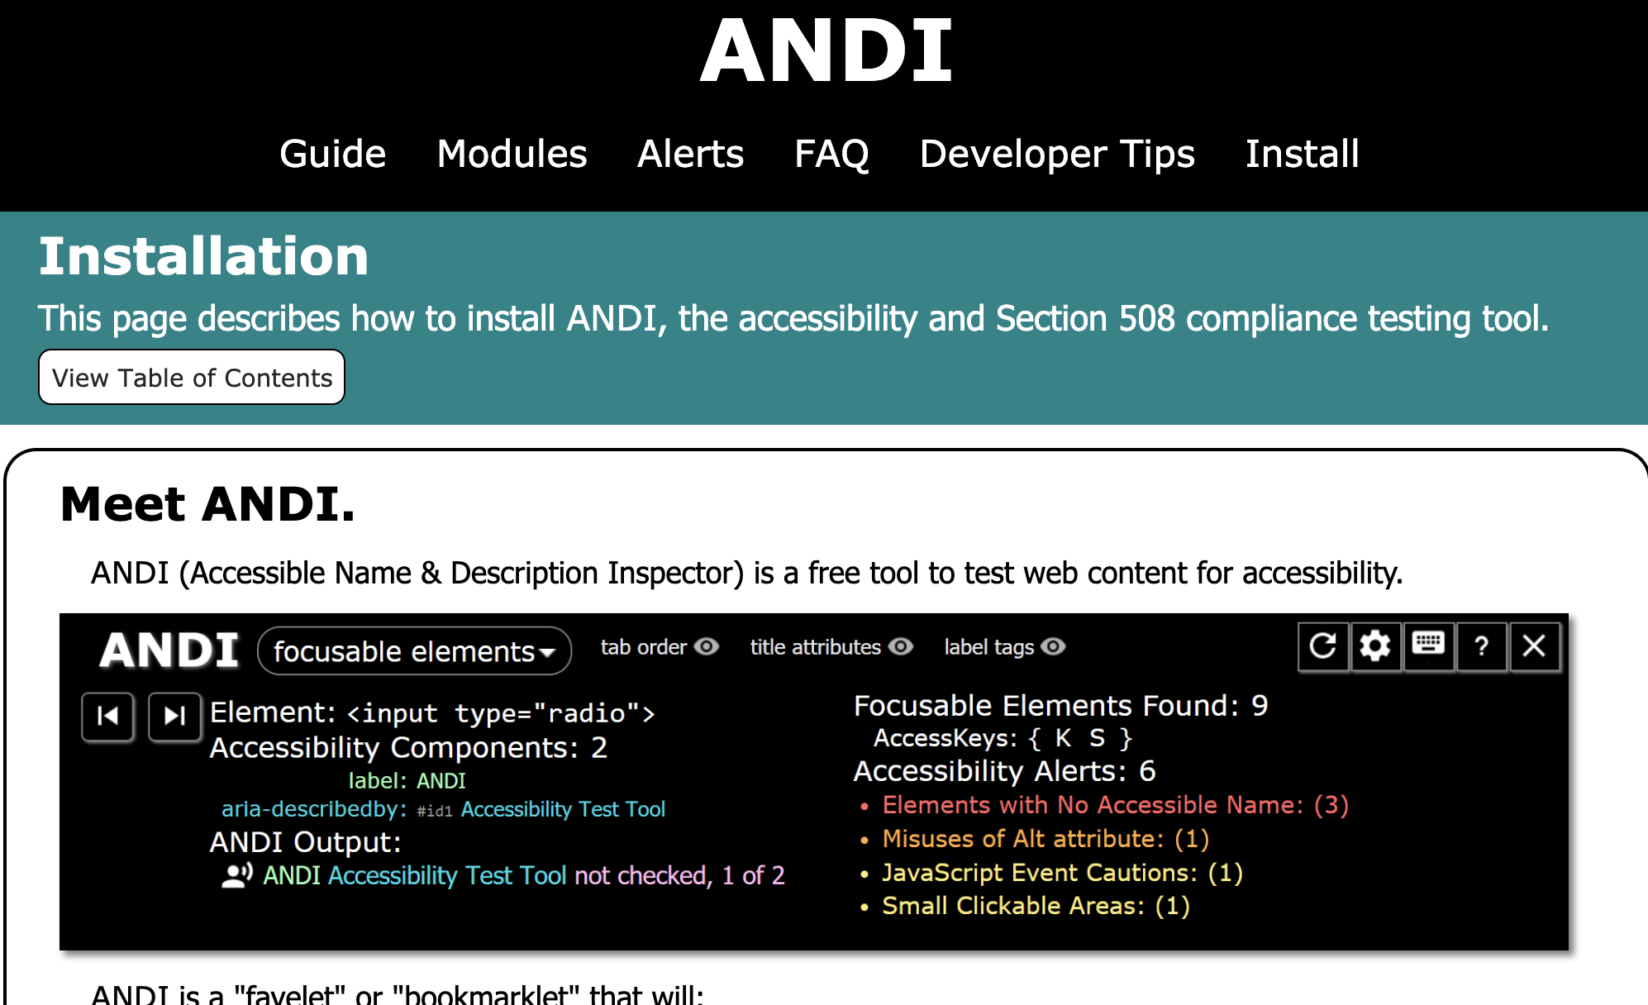
ANDI

Slide 22
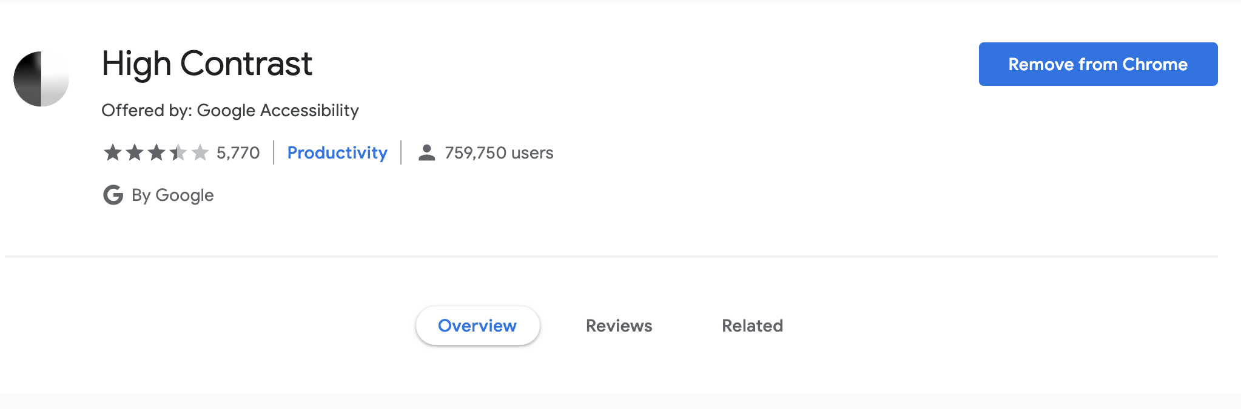
High Contrast (chrome extension)
https://chrome.google.com/webstore/detail/high-contrast/djcfdncoelnlbldjfhinnjlhdjlikmph?hl=en

Slide 23
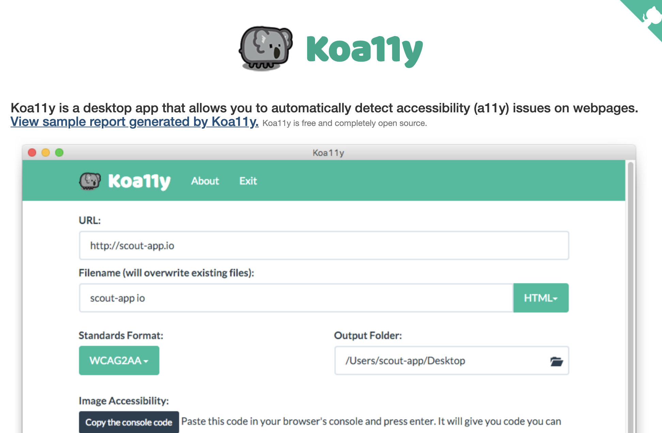
Koa11y (Desktop App)
https://open-indy.github.io/Koa11y

Slide 24
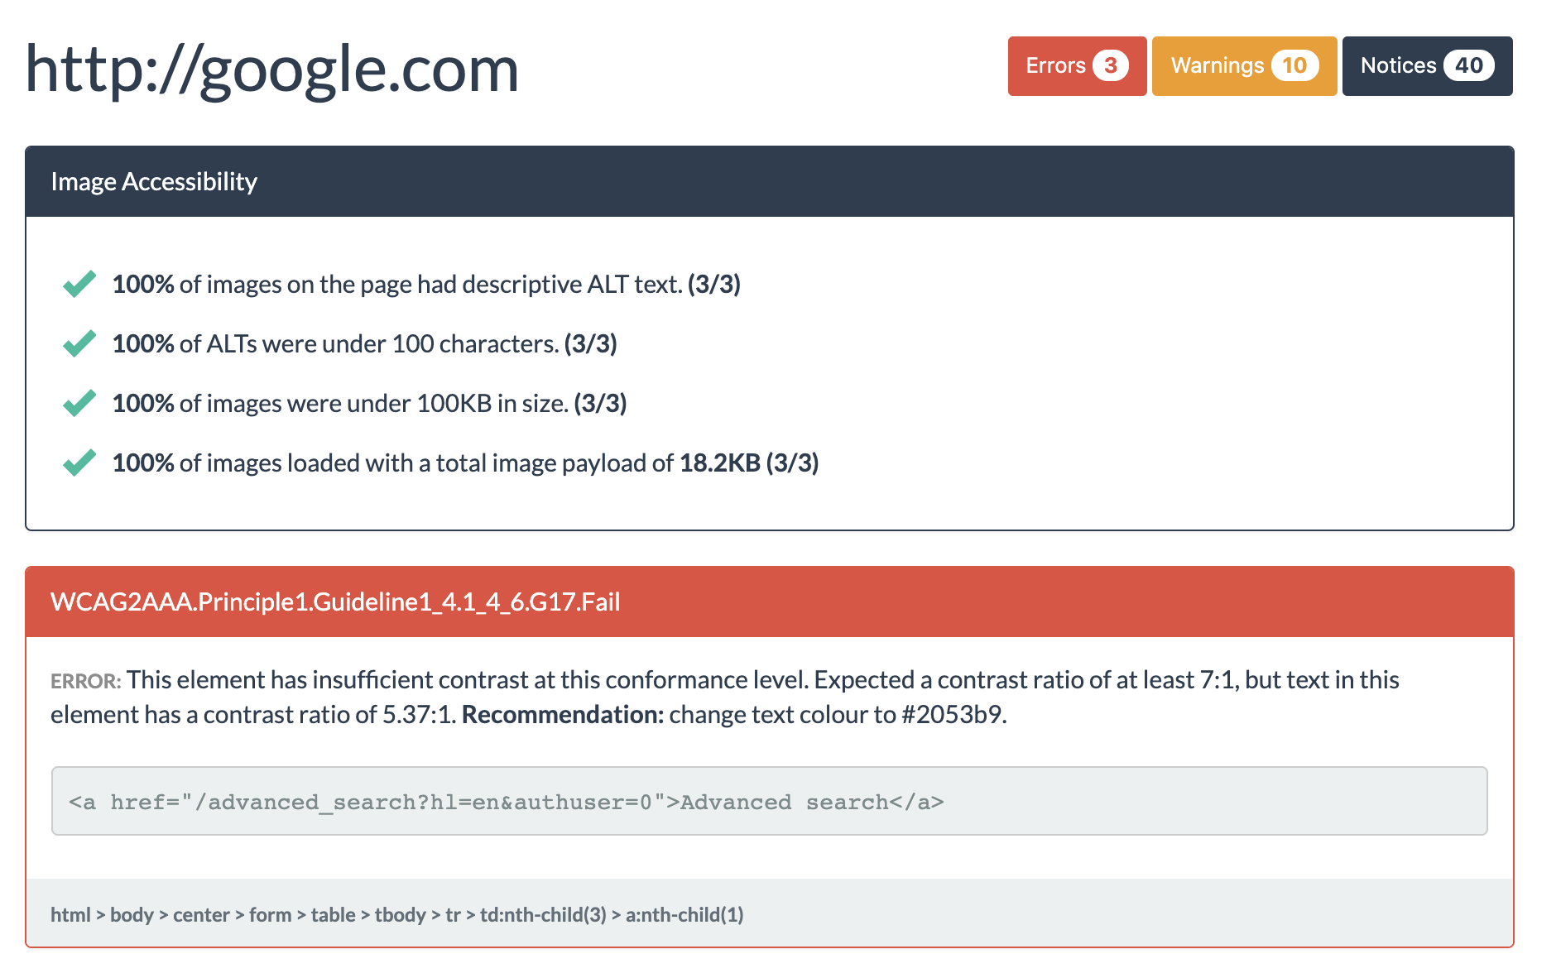
Koa11y (Desktop App)
https://open-indy.github.io/Koa11y

Slide 25
15 min - download some of the tools and try them
https://accessibilityinsights.io
Lighthouse - in Chrome
SiteImprove - Google SiteImprove Browser Extension
ANDI - https://www.ssa.gov/accessibility/andi/help/install.html
High Contrast - Google High Contrast
KoA11y - https://open-indy.github.io/Koa11y

Slide 26
Group Questions

Slide 27
Automated Tools
(Scripting involved)

Slide 28
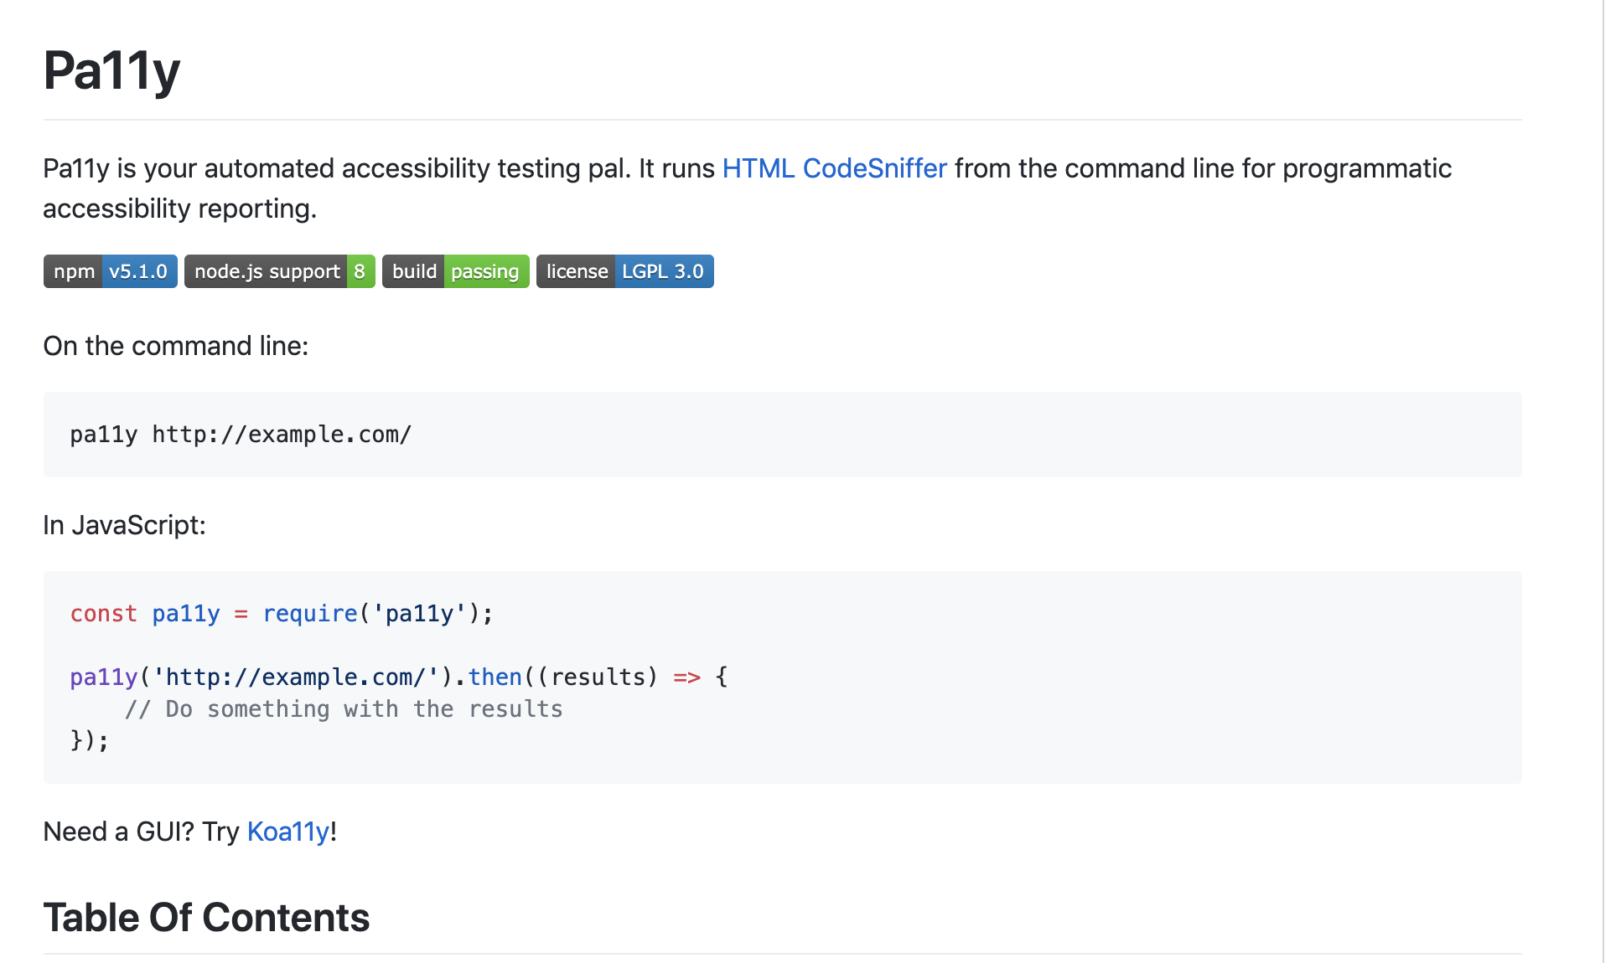
pA11y
https://www.ssa.gov/accessibility/andi/help/install.html

Slide 29
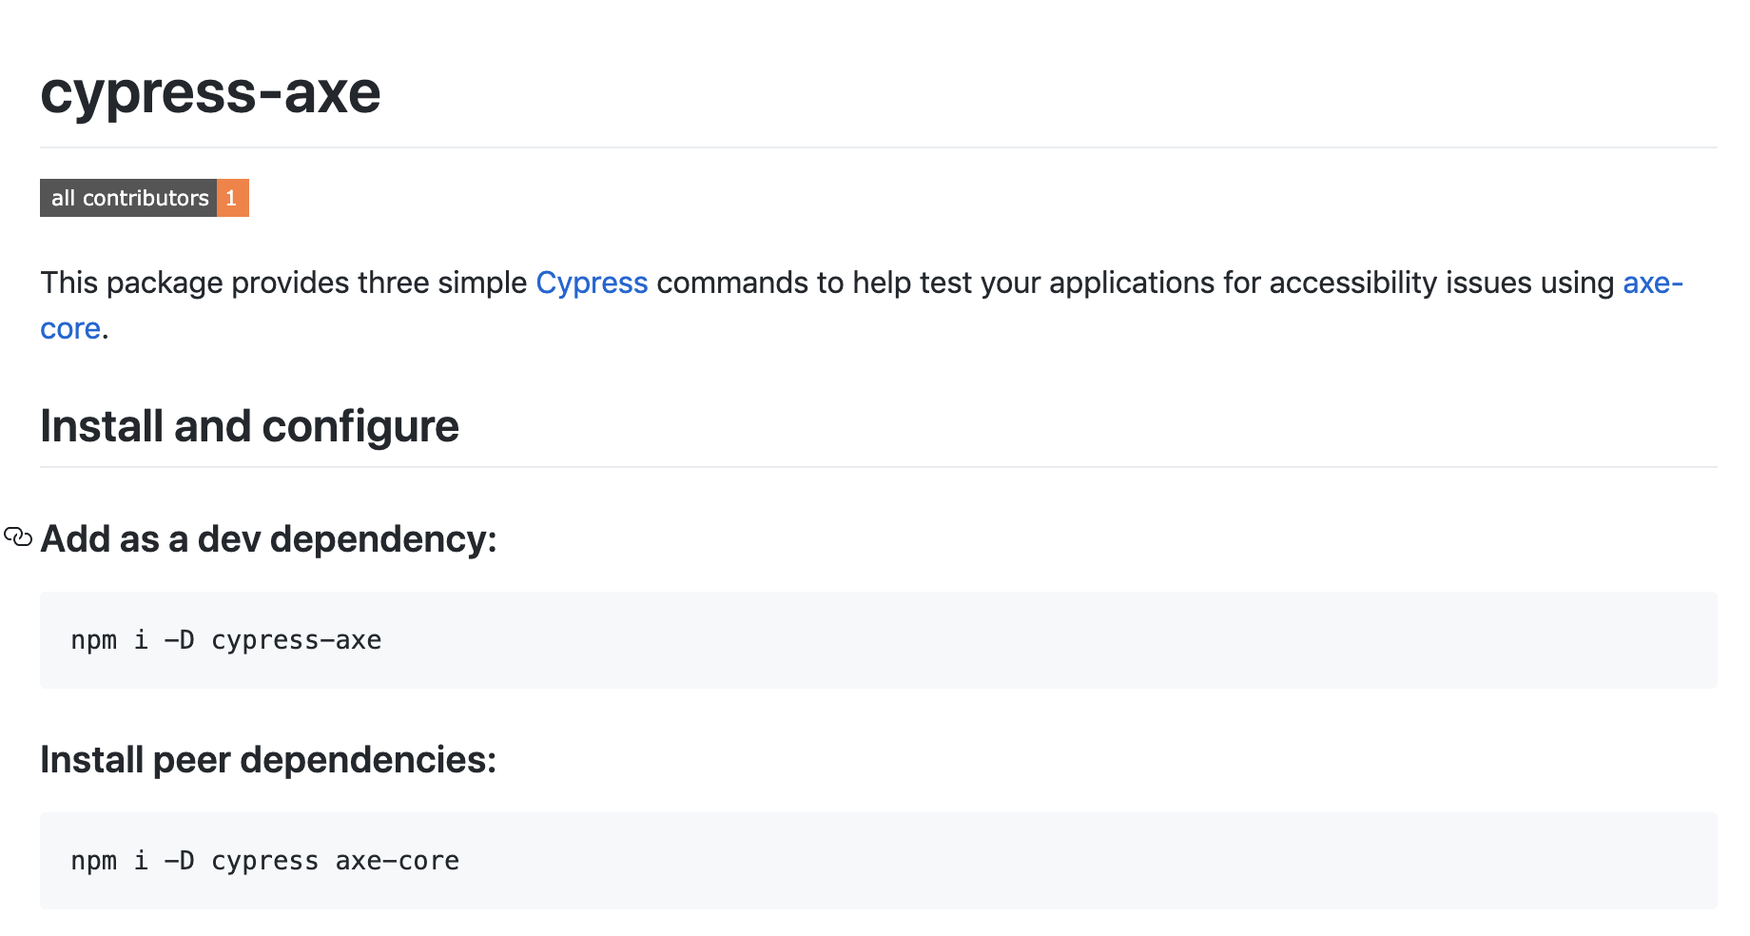
Cypress.io
https://github.com/avanslaars/cypress-axe

Slide 30
Other options

Slide 31
Top issues

Slide 32
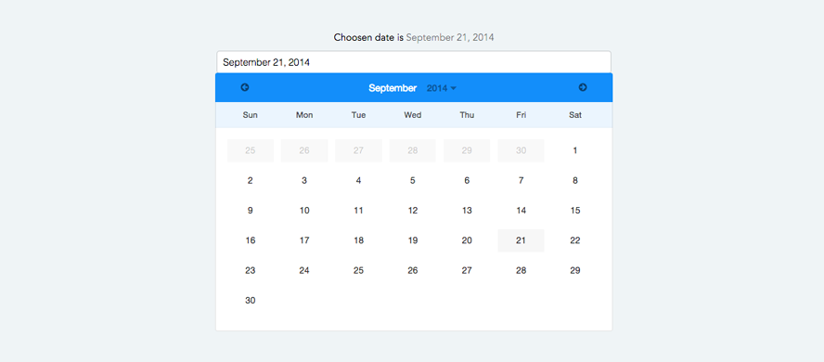
Site is keyboard accessible
All interactions can be accessed with a keyboard
https://a11yproject.com/posts/navigate-using-just-your-keyboard/

Slide 33
Site is free of keyboard traps
The keyboard focus is never trapped in a loop:
<input id="ssn" type="text" value="" onblur="this.focus();">

Slide 34
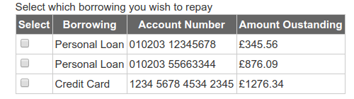
All form inputs have explicit labels

Slide 35
All relevant images use an img tag
Use IMG if you intend to have people print your page and you want the image to be included by default.
Use IMG (with alt text) when the image has an important semantic meaning, such as a warning icon. This ensures that the meaning of the image can be communicated in all user-agents, including screen reader
Use CSS background images if the image is not part of the content.
Use CSS background images when doing image-replacement of text eg. paragraphs/headers.
Use background-image if you intend to have people print your page and you do not want the image to be included by default.
Use background-image if you need to improve download times, as with CSS sprites.
Use background-image if you need for only a portion of the image to be visible, as with CSS sprites.
Use background-image with background-size:cover in order to stretch a background image to fill its entire window.
s.

Slide 36

All images have alt attributes
<img src=”cat.png” alt=”Picture of a car” />

Slide 37
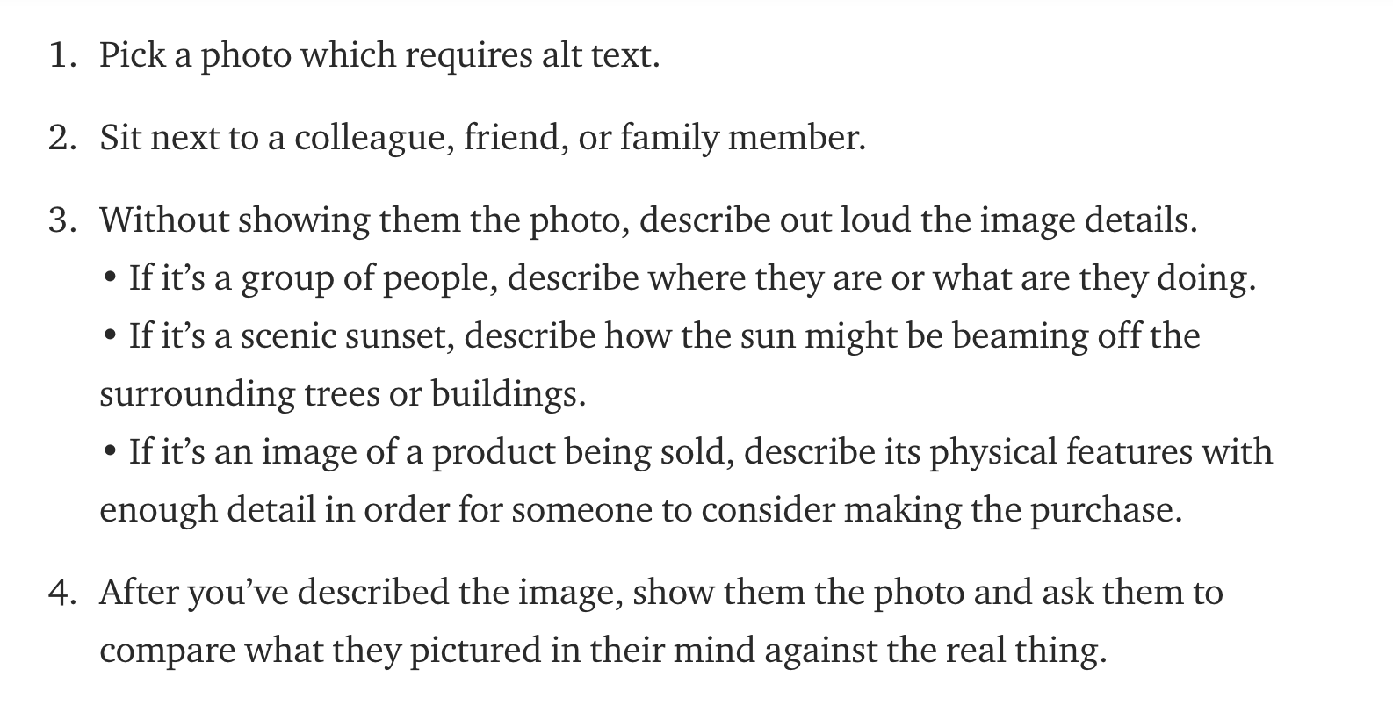
All images have alt attributes
Considerations when writing alt text - Scott Vinkle

Slide 38
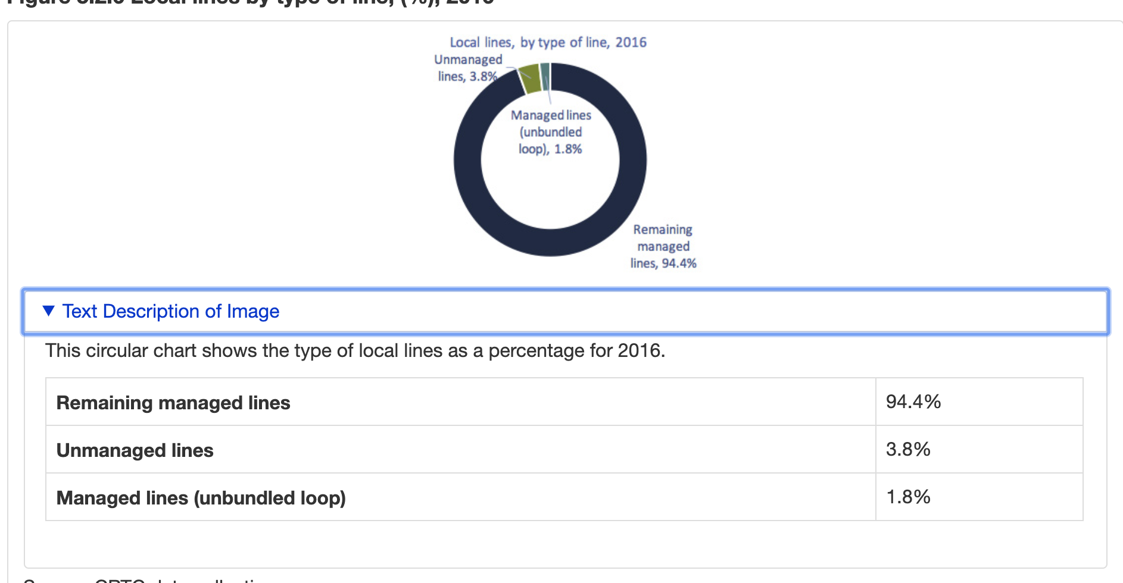
Charts and Infographics

Slide 39
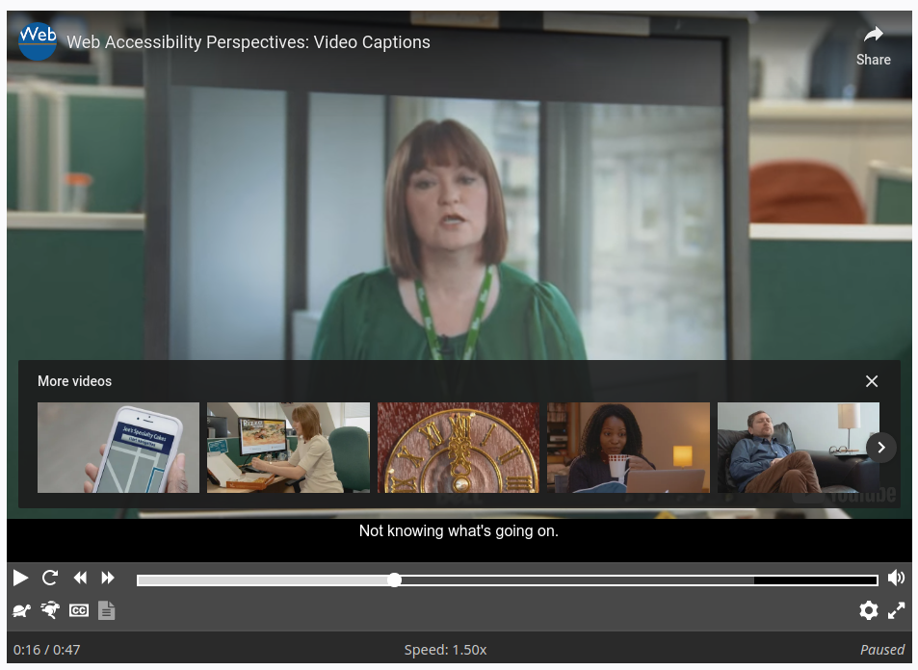
Multimedia is tagged
All multimedia has appropriate captioning and audio description

Slide 40
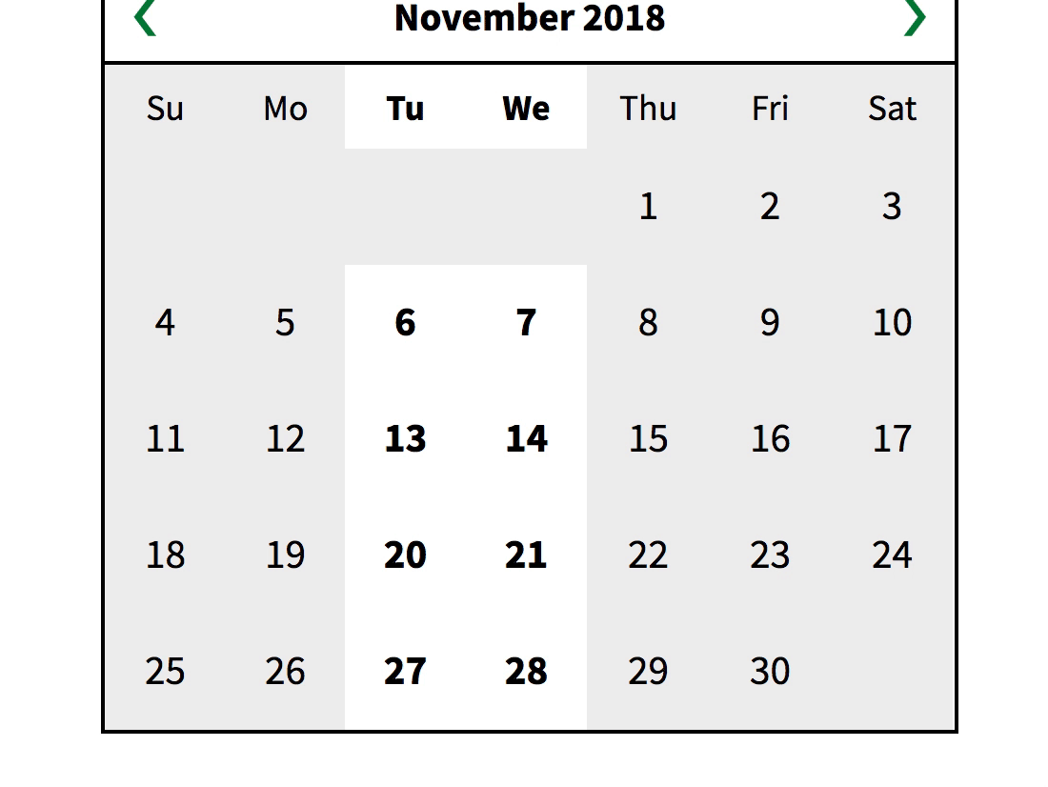
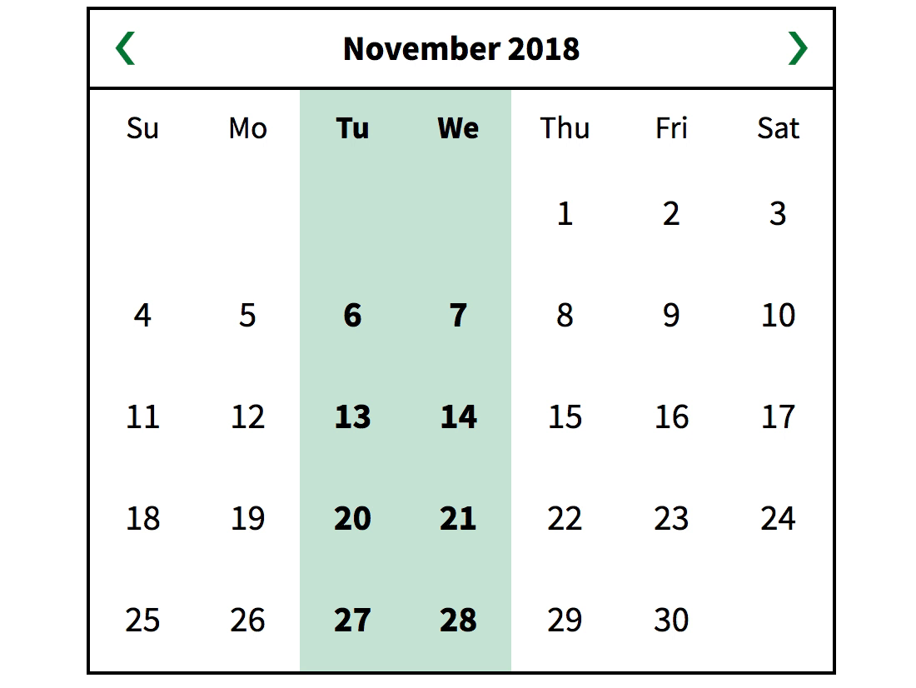
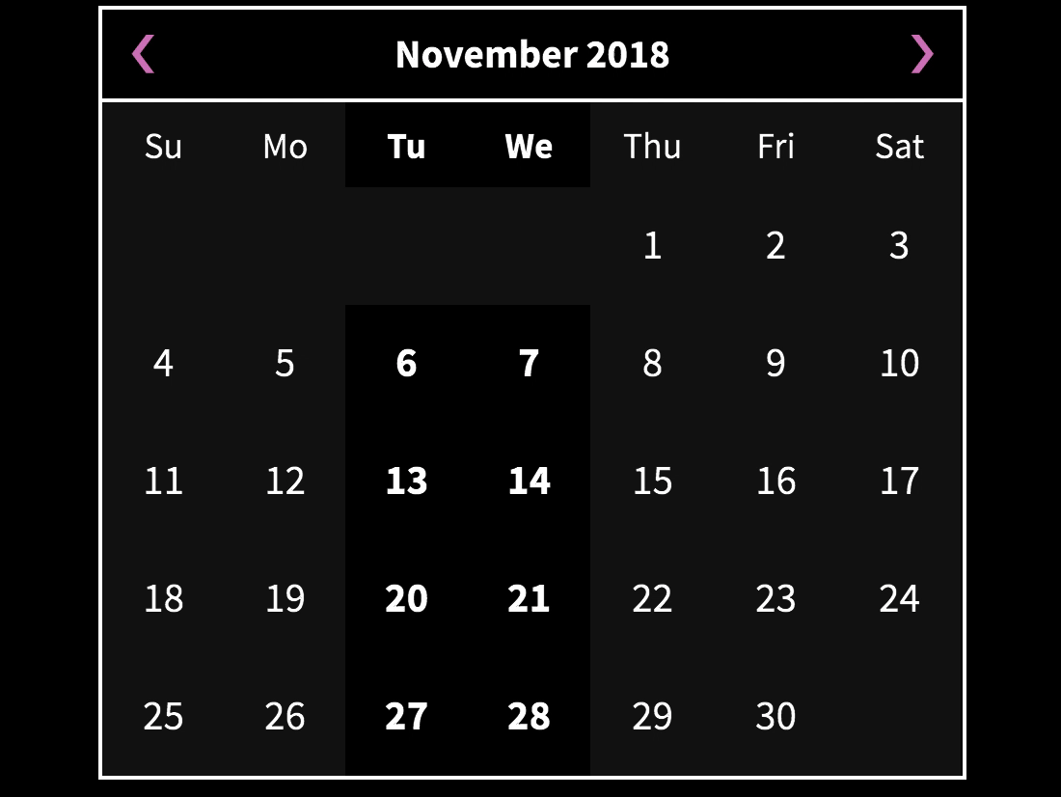
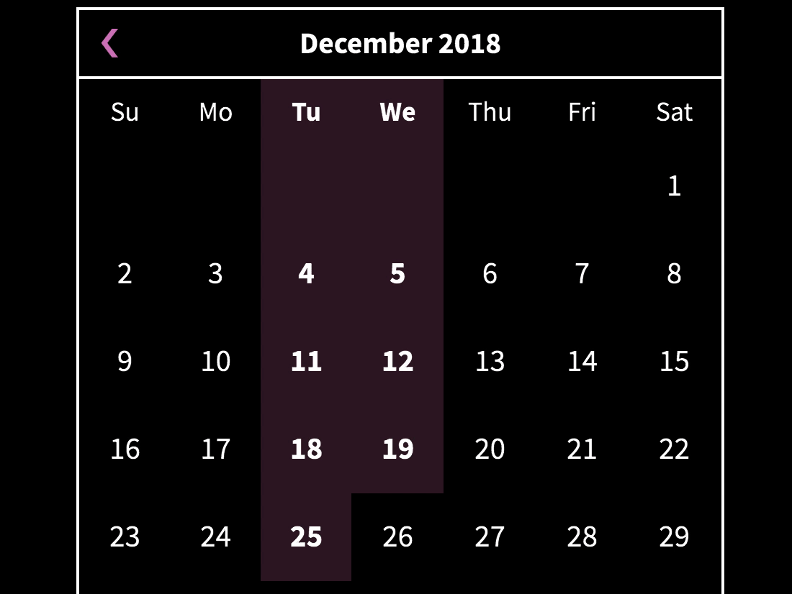
Text has sufficient color contrast
All text has a contrast ratio of 4.5:1 with the background

Slide 41
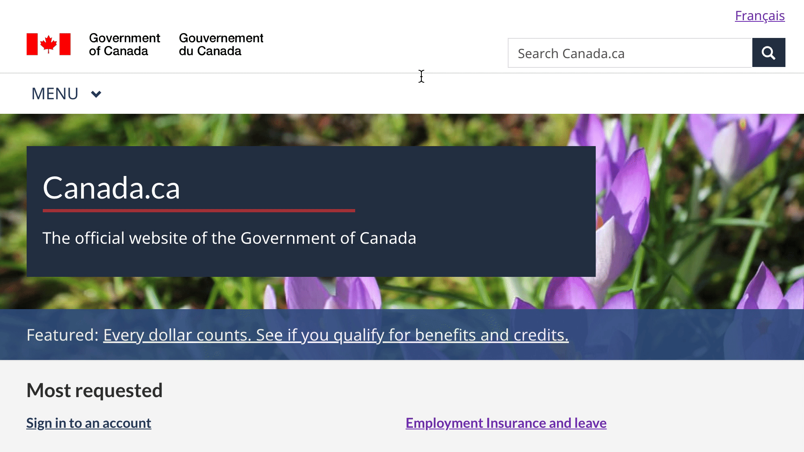
Site never loses focus
Focus is always visible when moving through the page with the keyboard

Slide 42
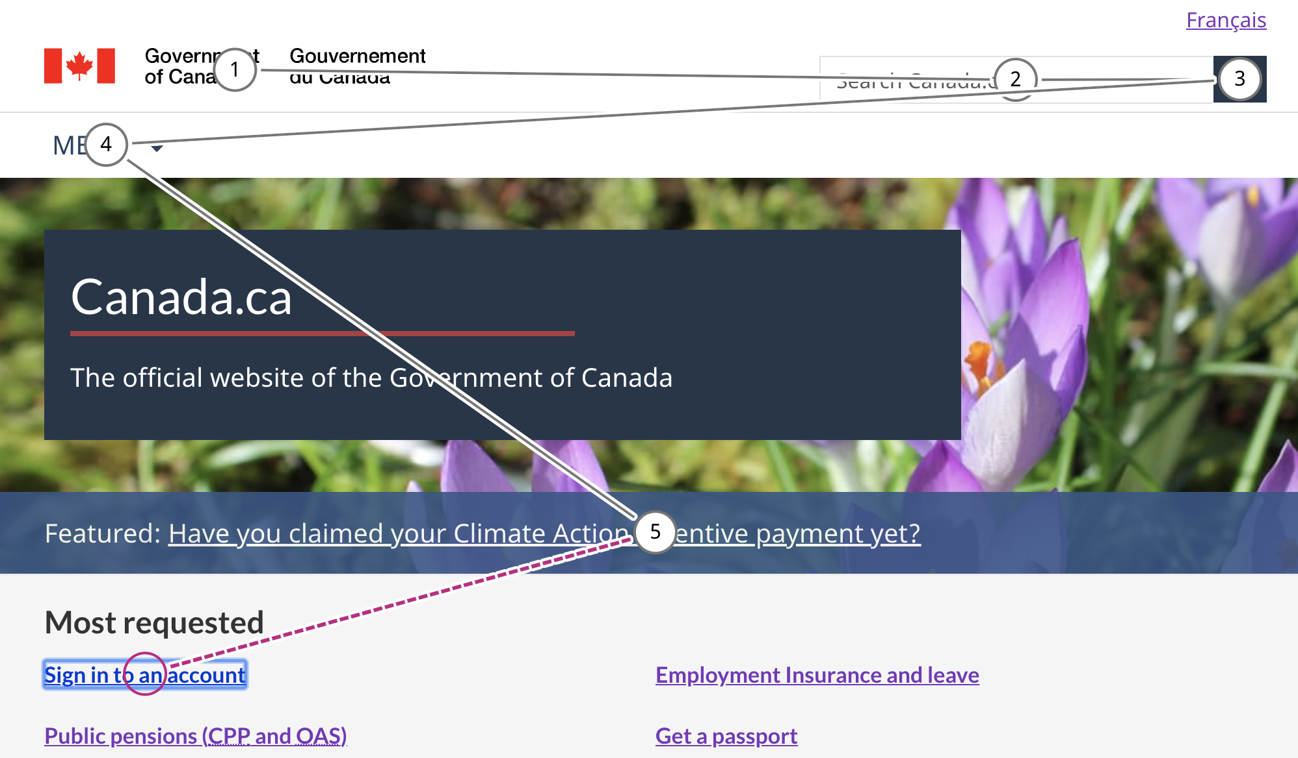
Tab order is logical

Slide 43
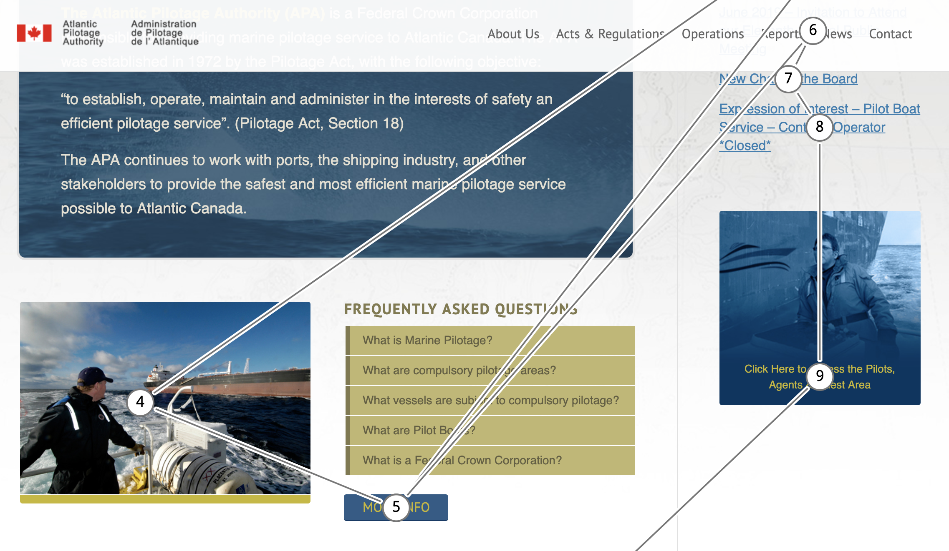
Tab order is logical?

Slide 44
Form instructions are associated with inputs
<label for="expire">Expiration date (MM/YYYY): </label> <input type="text" name="expire" id="expire">

Slide 45
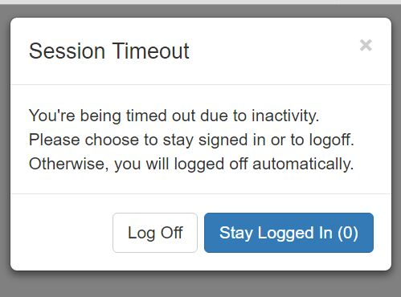
Site doesn't timeout unexpectedly
Identify elements that may "timeout" and verify that the user can request more time

Slide 46
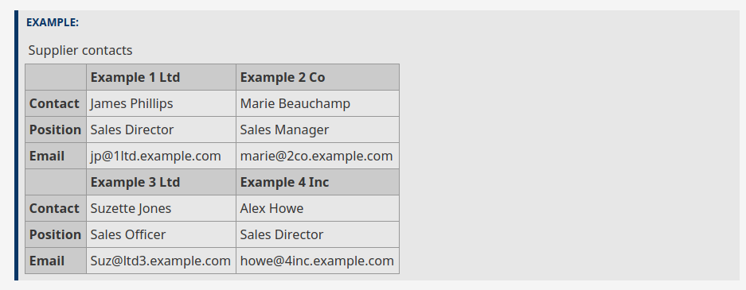
Tables are coded properly
Tables have proper headers and column attributes

Slide 47
Headings are nested properly
Heading elements are nested in a logical way
<h1>Setting the Exposure Manually on a Camera</h1>
<p>Put text here...</p>
<h2>Set the ISO</h2>
<p>Put text here...</p>
<h2>Choose an aperture</h2>
<p>Put text here...</p>
<h2>Choose a shutter speed</h2>
<p>Put text here...</p>

Slide 48
Language is set
The language for the page is set
The language for sections on the page that differ from the site language are set:
<!DOCTYPE html><html lang="en">
Or
<!DOCTYPE html><html lang="fr">
Or
<!DOCTYPE html><html lang="{YOUR LANGUAGE OF CHOICE}">

Slide 49
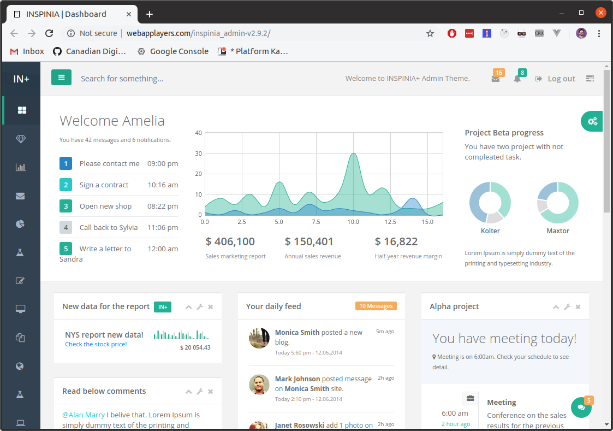
Only symbols
Identifying content only by its shape or location or using graphical symbol alone to convey information

Slide 50
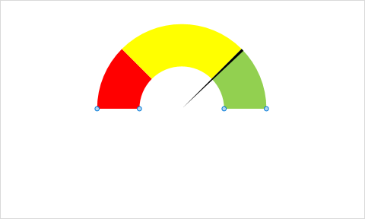
Use of colour
Not using colour alone to convey meaningful information

Slide 51
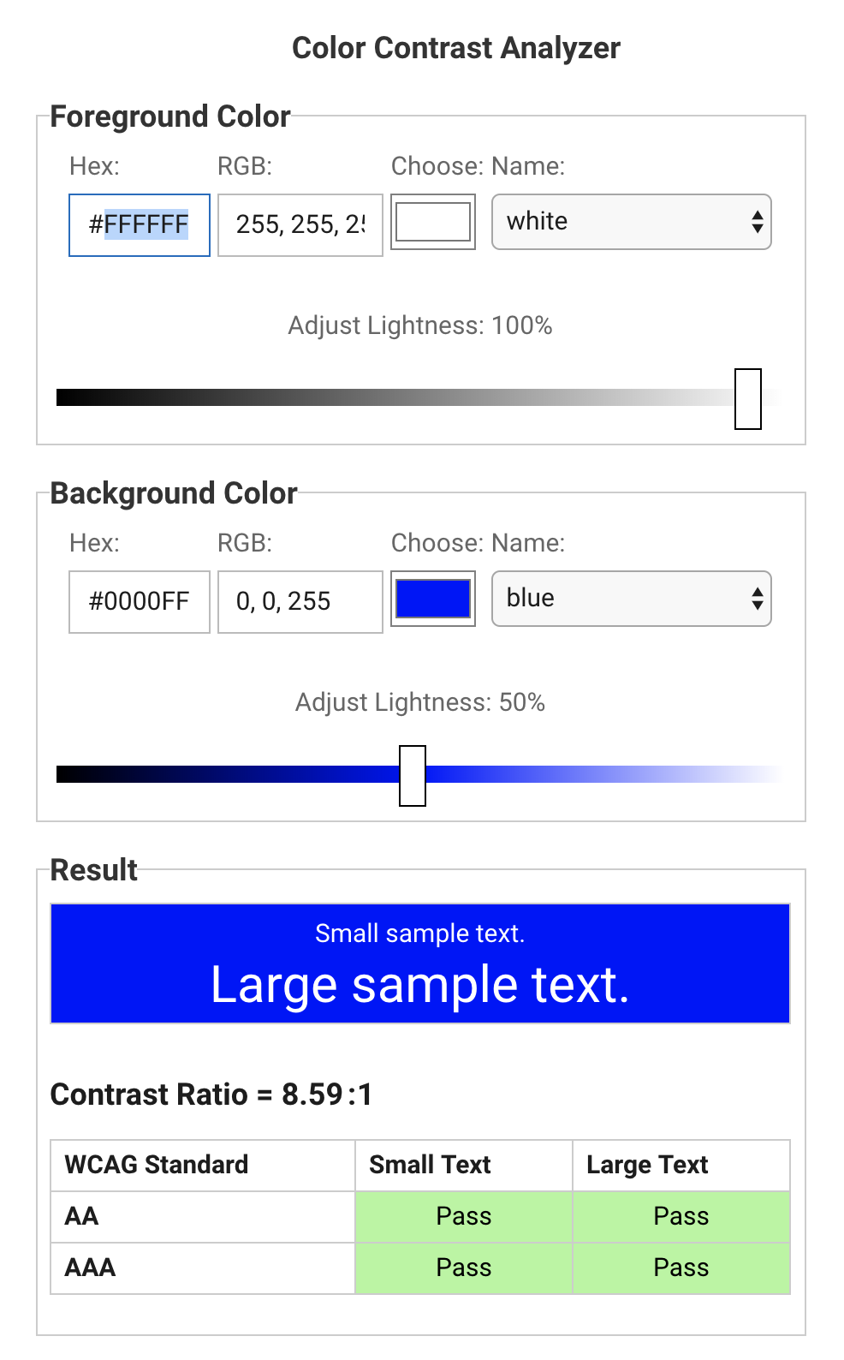
Use of colour - (contrast)
https://dequeuniversity.com/rules/axe/3.1/color-contrast?application=lighthouse
https://contrastchecker.com

Slide 52
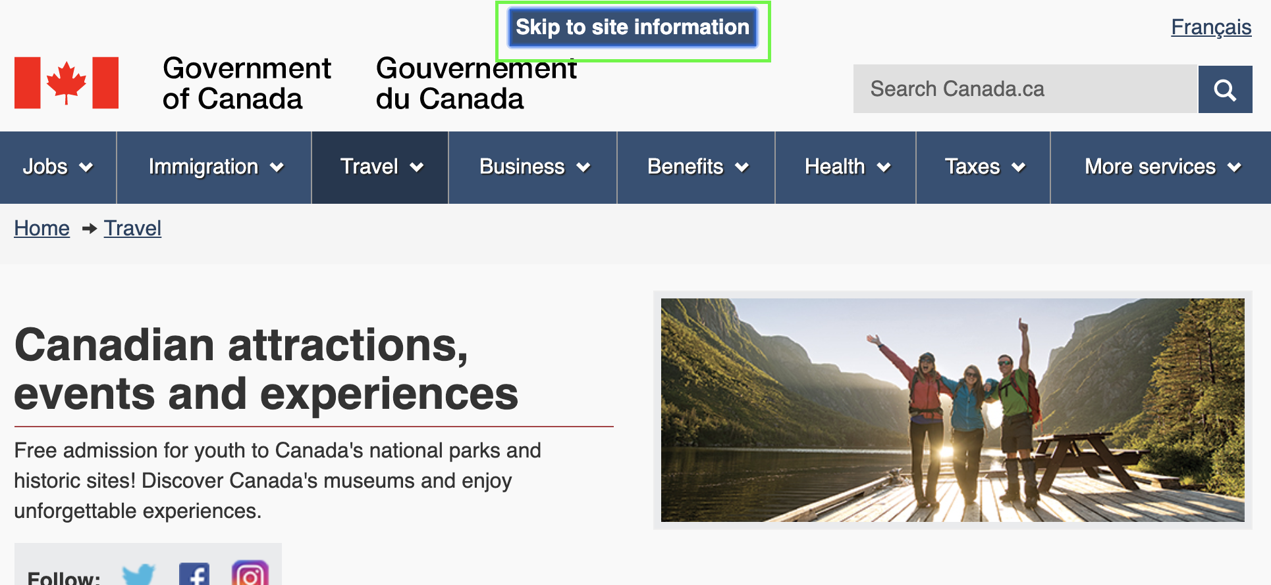
Skip links
Available to bypass blocks of content that are repeated on multiple Web pages

Slide 53
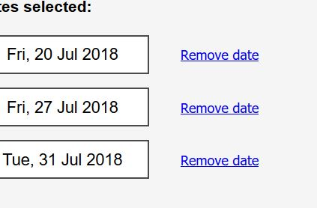
Links are unique and contextual
All links can be understood taken alone

Slide 54
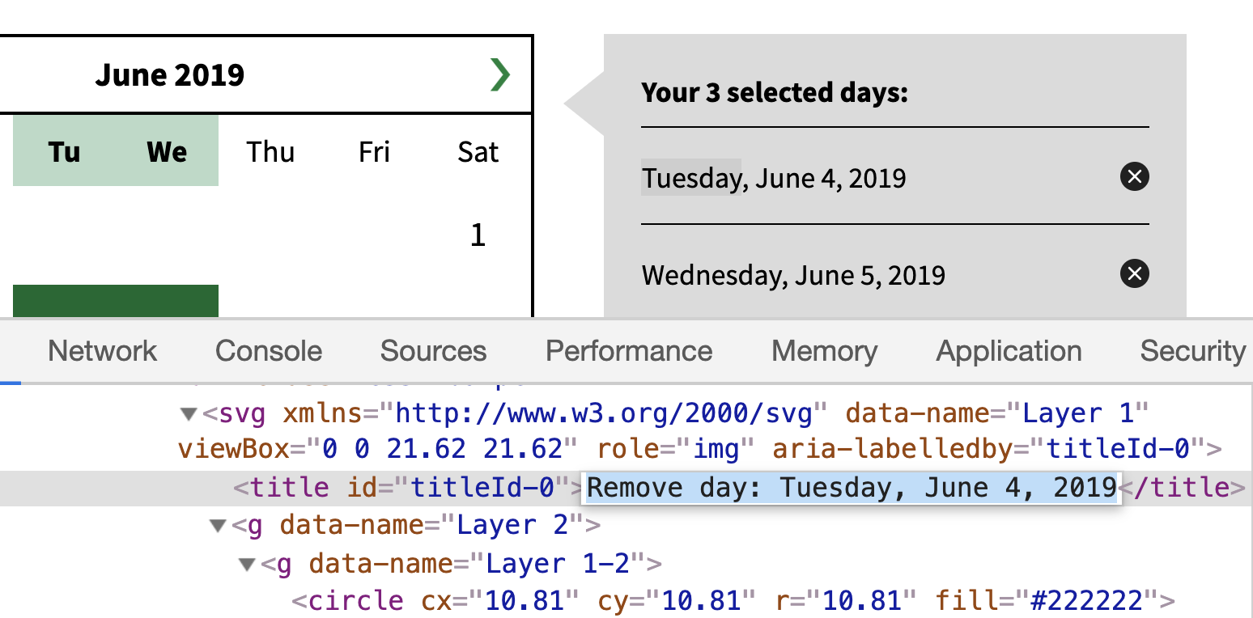
Links are unique and contextual

Slide 55
Uncaught Issues

Slide 56
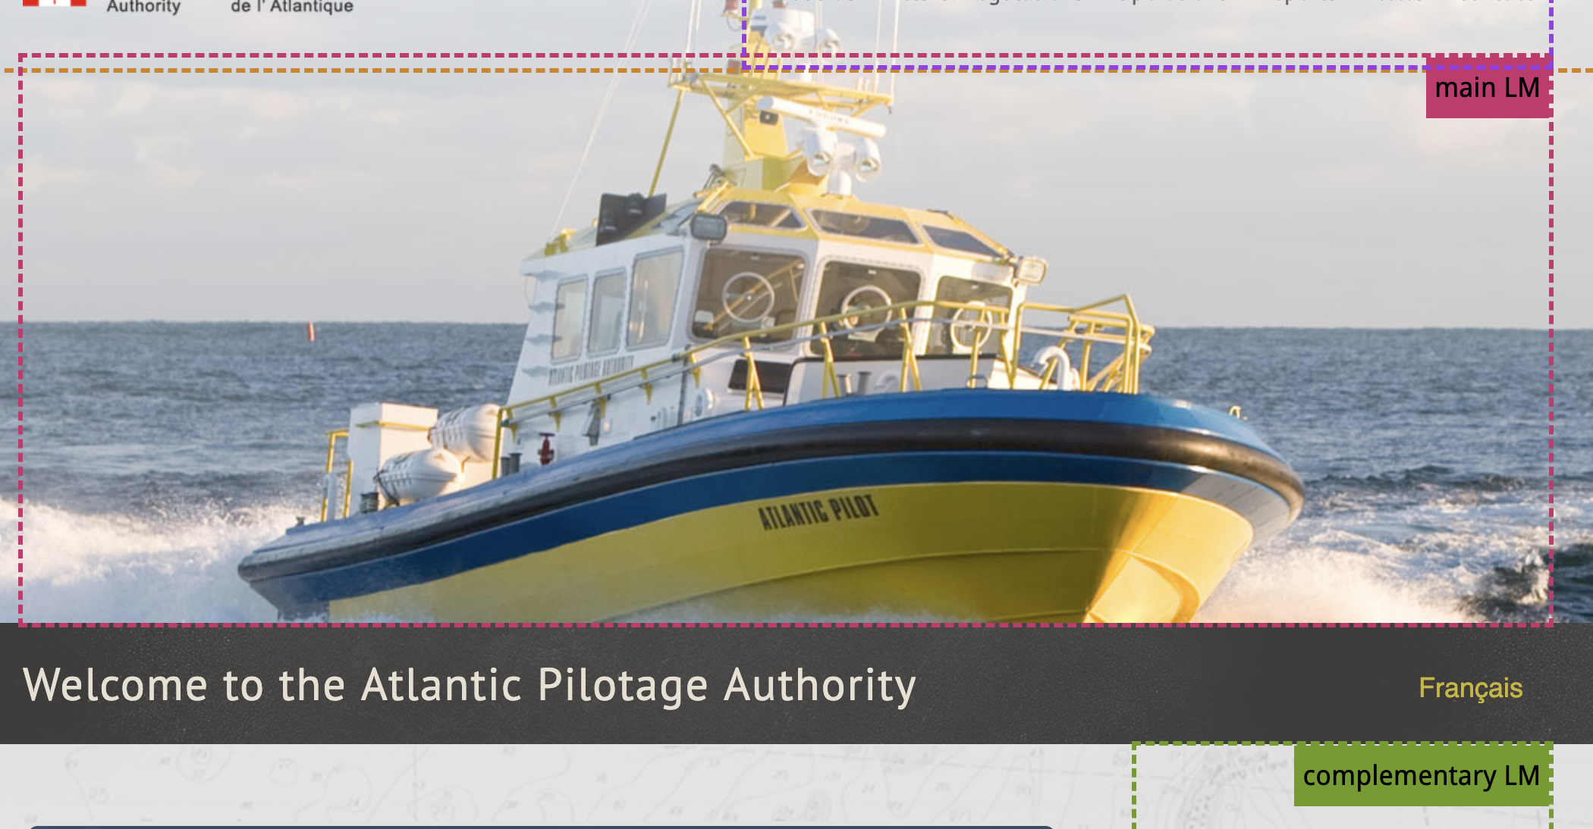
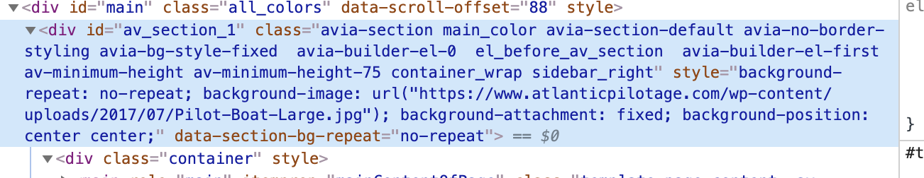
Bad Landmark

Slide 57
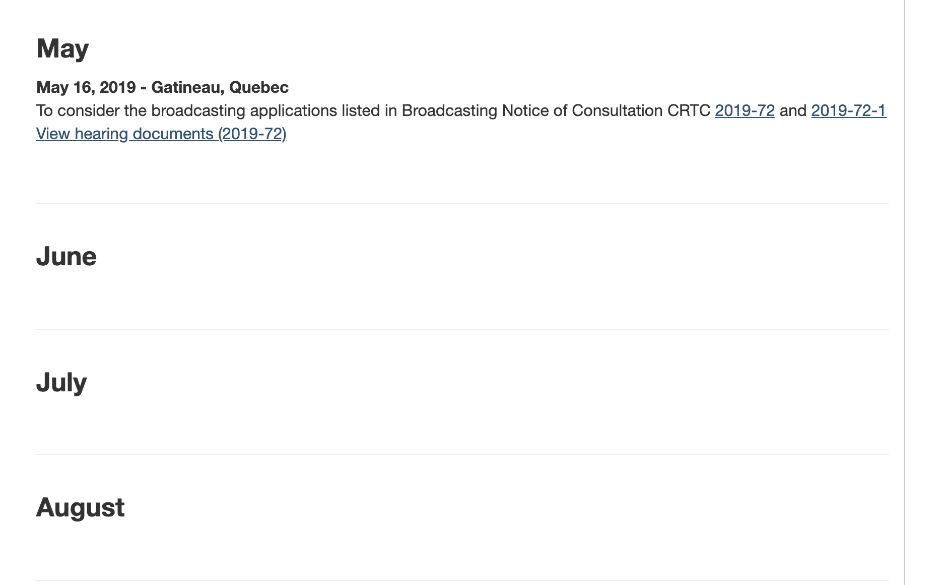
Missing Information
https://crtc.gc.ca/eng/process/pcal2019.htm

Slide 58
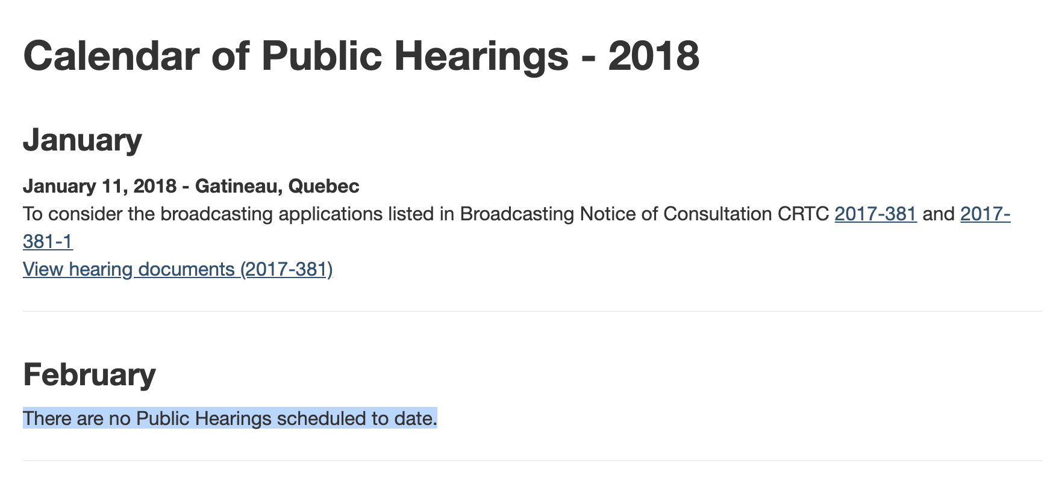
Missing Information (Better)
https://crtc.gc.ca/eng/process/pcal2018.htm

Slide 59
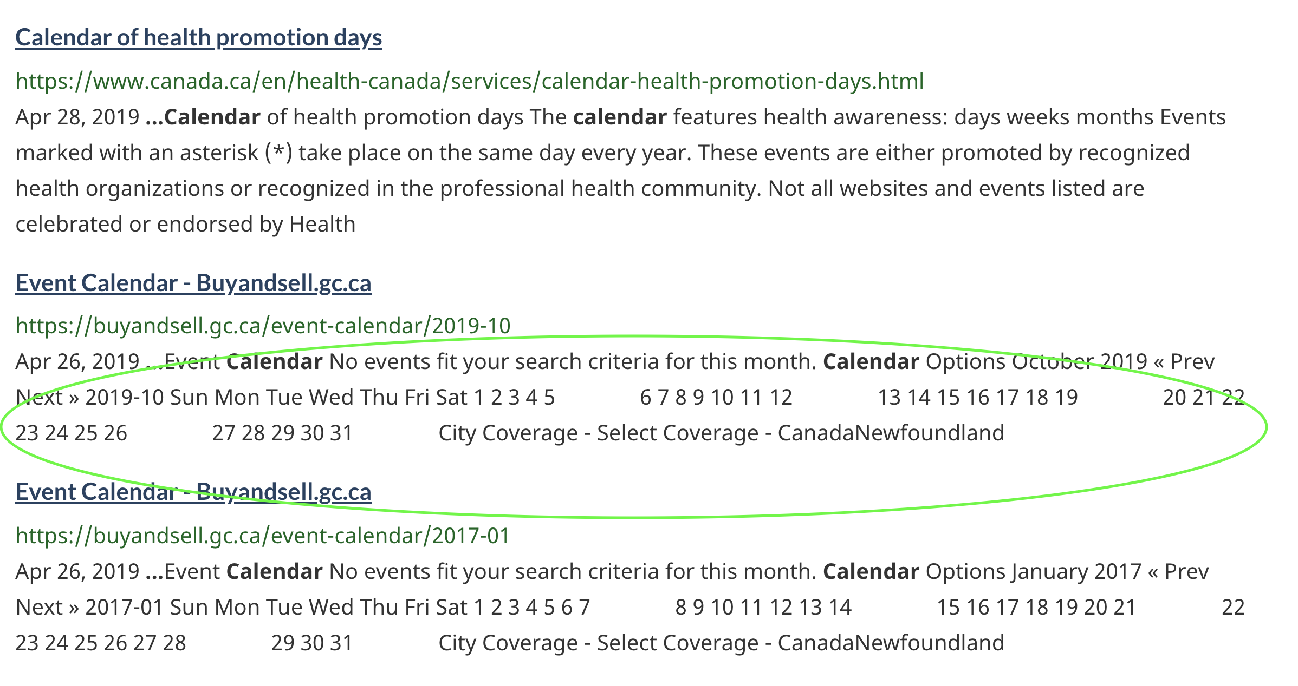
Content Issues
https://www.canada.ca/en/sr/srb.html?cdn=canada&st=s&num=10&langs=en&st1rt=1&s5bm3ts21rch=x&q=calendar&_charset_=UTF-8&wb-srch-sub=

Slide 60
Thank you!
Merci!
digital.canada.ca · @CDS_GC | numerique.canada.ca · @SNC_GC

